Slide 1
SCIENTIFIC POSTER DESIGN
Miha Klasinc • The Mind • Fall 2017 • NYU Abu Dhabi

Slide 2



EXAMPLES

Slide 3
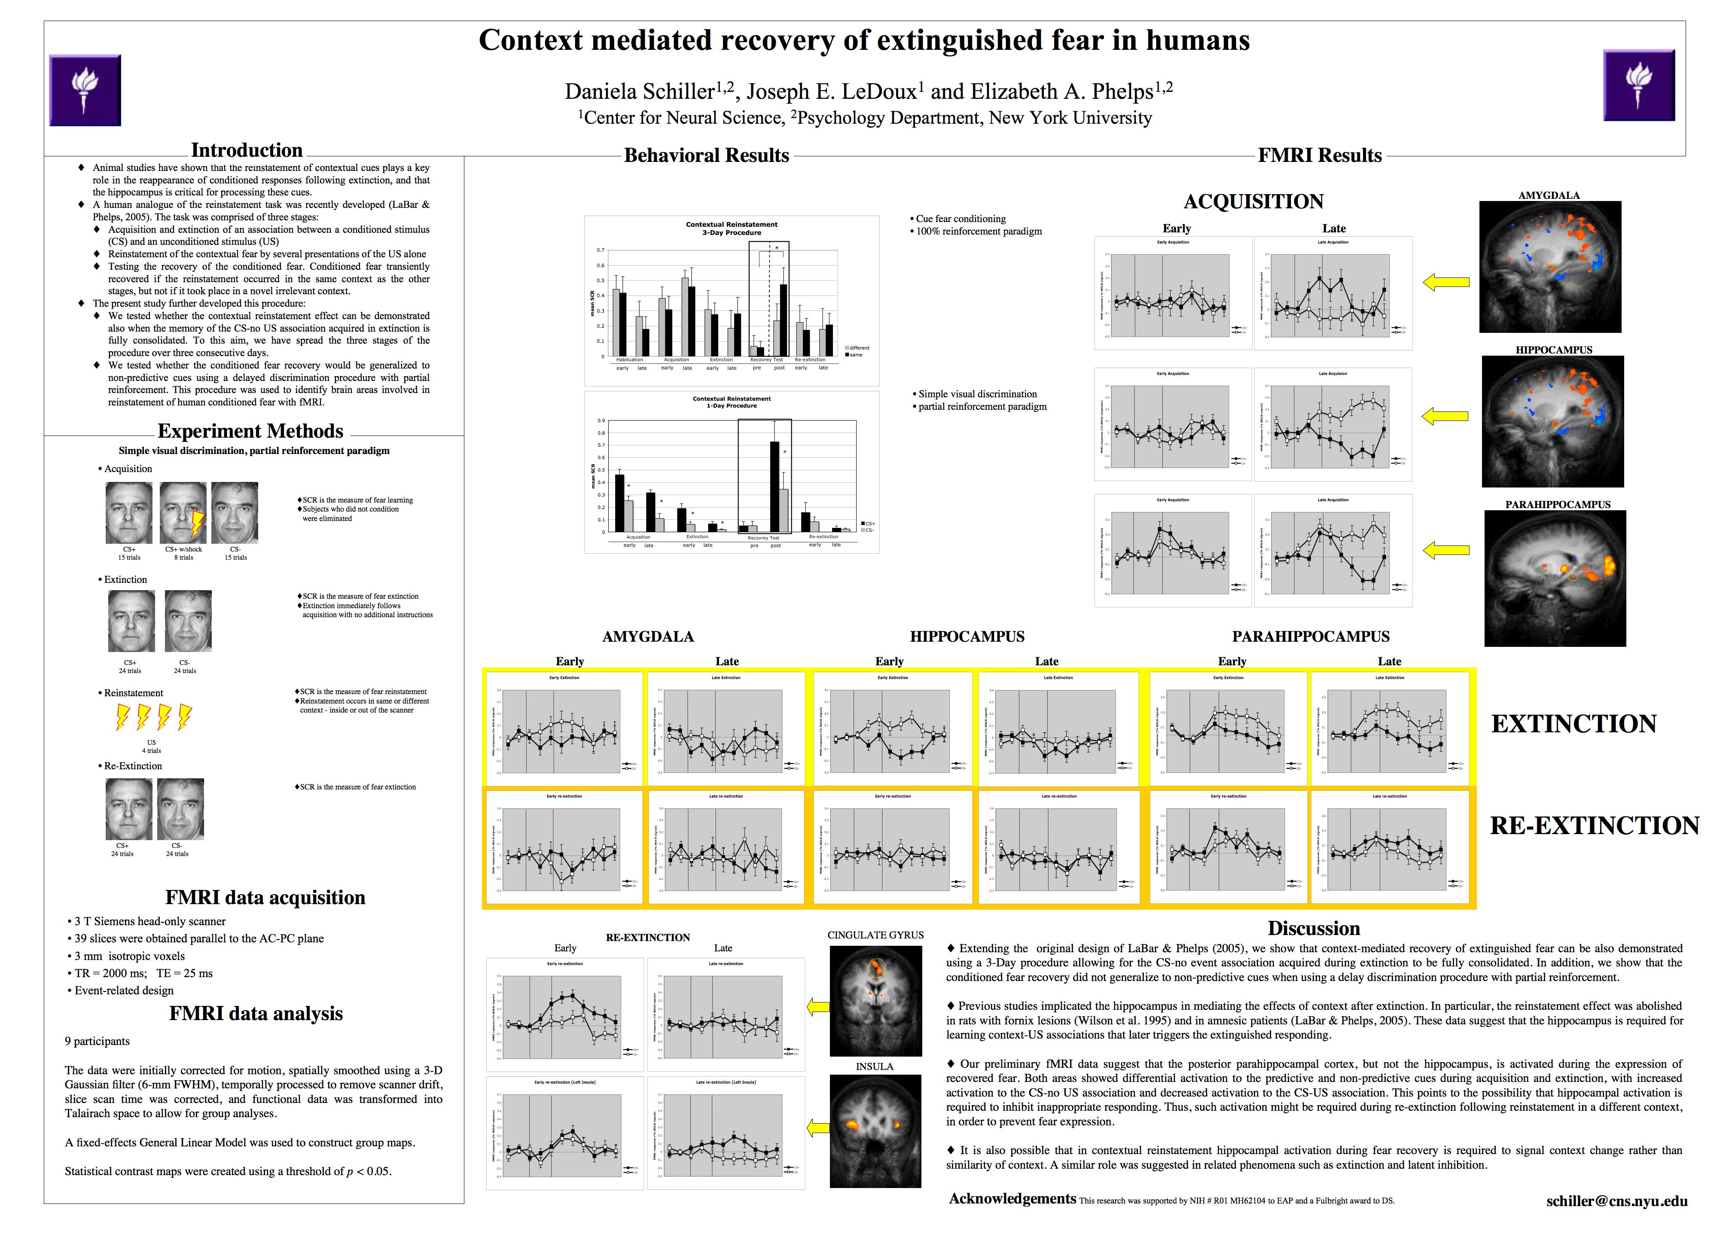

Slide 4


Slide 5
Adobe InDesign

Slide 6
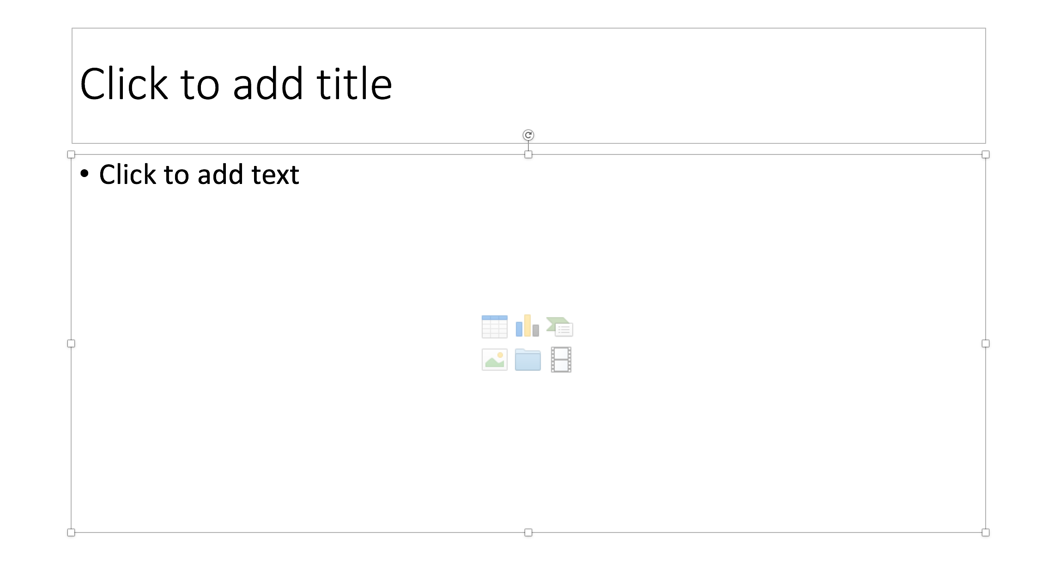
Powerpoint

Slide 7
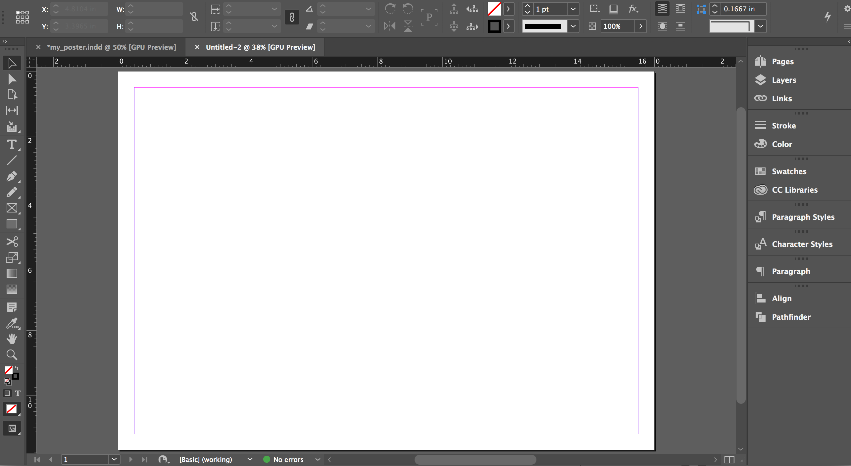
InDesign

